Slide 1
Network Embedding as Matrix Factorization: Unifying
DeepWalk, LINE, PTE, and node2vec
Qiu et al. 2018
Better Together JSALT 2023
Reading Group Session #1
Peter Vickers (University of Sheffield)

Slide 2
High-level Summary
We have online algorithms for learning graph embeddings. These vector graph embeddings embeddings represent the structural context of nodes in a graph.
Methods Discussed:
DeepWalk (walk length > 1 edges)
LINE (walk length = 1 edge)
PTE
Node2vec (second order walk with > 1 edges)
Propose a new Matrix-Factorisation based method NetMF which is shown to approximate DeepWalk
Both online algorithms and Qiu et als’ analysis influenced by Skip-Gram word embedding model

Slide 3
Research Questions
How are online graph embedding algorithms related?
Can we derive closed-form representations of methods?
Given these closed-form representations, can we learn and optimize this way?

Slide 4
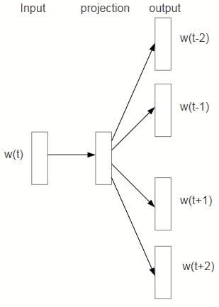
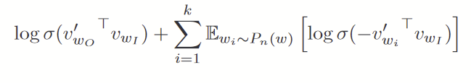
… Back to Skip-Gram
Skip-Gram with Negative Sampling from Distributed Representations of Words and Phrases and their Compositionality (Mikolov et al 2013)
Learn vector representations for word w(t) (aka w) through their proximity with other words w(t±k) (aka c)
Instead of a softmax for the probability of a word, use a logistic regression against k negative samples NEG Sampling:

Slide 5
Levy and Goldbergs’ Analysis
Gives full loss:
This will create embeddings matrices W and C for word and context embeddings respectively
We can think of Skip-Gram as learning W · C^{T} = M
Skip-Gram is then factorising M into |V_{W}| × |V_{C}|
In M, rows corresponds to words, columns to contexts, and cells a measure of association f(w, c)

Slide 6
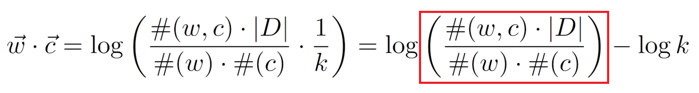
Neural Word Embedding as Implicit Matrix Factorization
Finally, Skip-Gram is factorising the PMI Matrix:
Red square is PMI of (w, c):

Slide 7
What does this mean for Graphs?
DeepWalk generates embeddings by taking random walks. It then performs Skip-Gram learning on those walks.
Obvious parallel to Levy and Goldbergs’ Analysis
Central Question: what is the Implicit Matrix M in the Graph Embedding Algorithms?

Slide 8
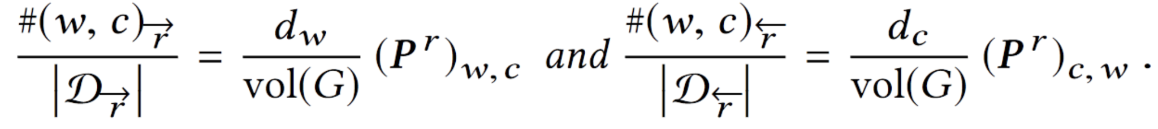
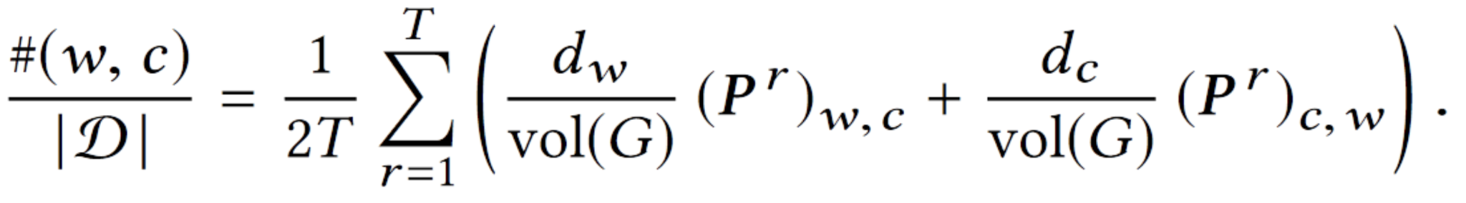
DeepWalk Implicit Matrix #(w,c)
First find the probability of finding #(w,c) with step length r:
Where P = D⁻¹A. Vol(G) = the sum of the Adjacency Matrix
Dropping the step length r we find:

Slide 9
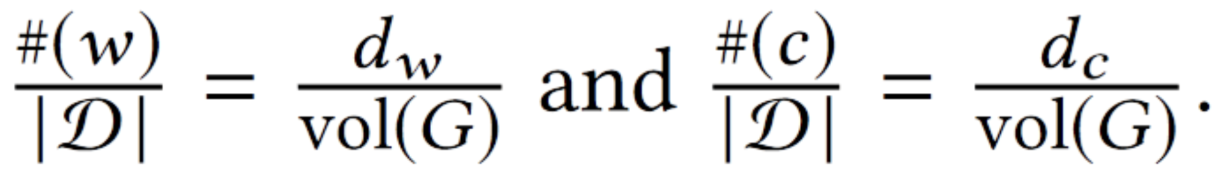
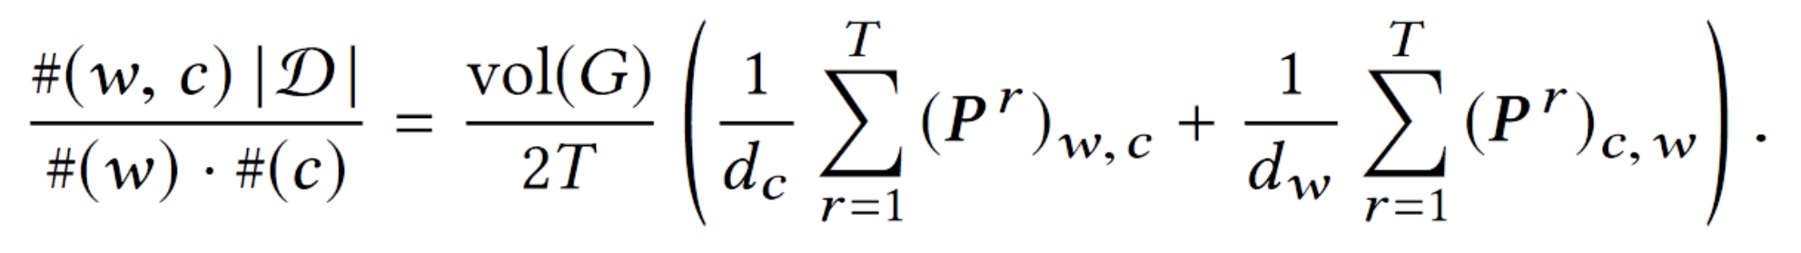
DeepWalk Implicit Matrix #(w), #(c)
The count # of w or c can be approximated as the degree of w or c divided by the volume of the graph:
Combining this with the previous result, we have:
DeepWalk is implicitly factoring this matrix

Slide 10
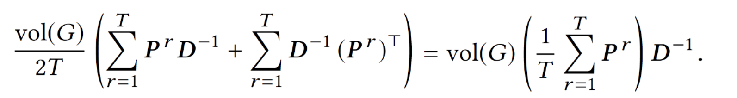
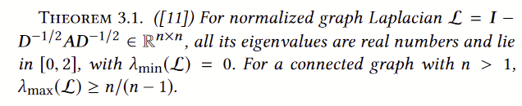
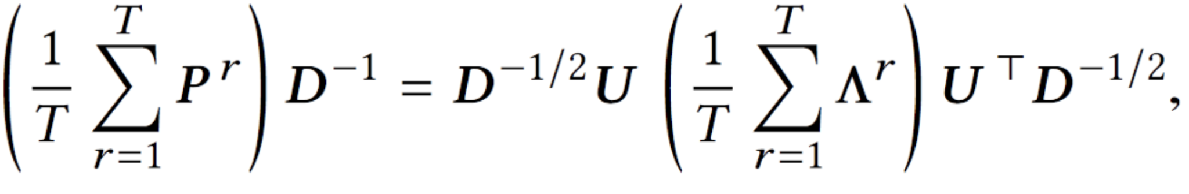
Considering the Laplacian
By dropping the constant terms and use of Theorem 3.1:
DeepWalk is in effect applying a transformation to the eigenvalues of the normalized Laplacian of the graph

Slide 11
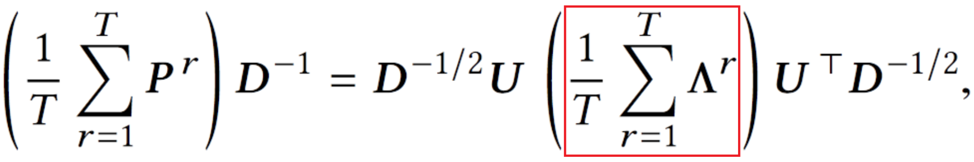
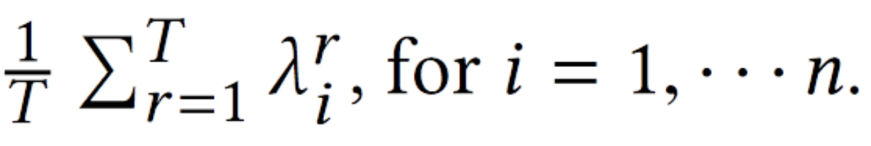
Normalized Graph Laplacian
New Eigenvalues from red are
These can be seen as the output of a transformation on original eigenvalues λ
Model this as a filter on the eigenvalues of the original graph

Slide 12
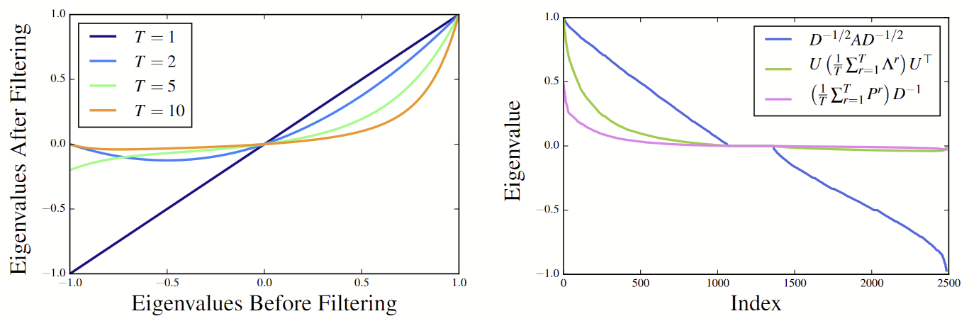
Properties of the Eigenvalue Filter
It prefers positive large eigenvalues
Secondly, the preference becomes stronger as window size T increases. I.e. as T grows, the filter tries to approximate a low-rank positive semi-definite matrix by keeping large positive eigenvalues.

Slide 13

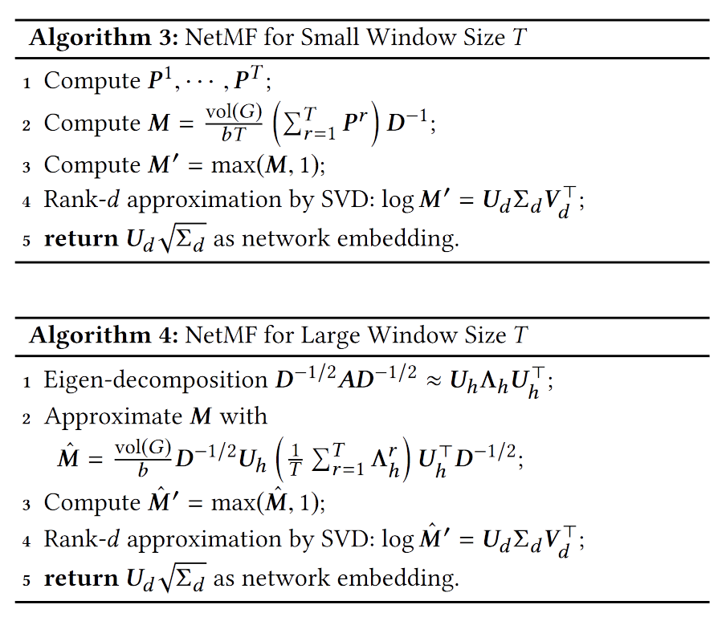
NetMF
Directly compute and factorise the DeepWalk inspired matrix

Slide 14
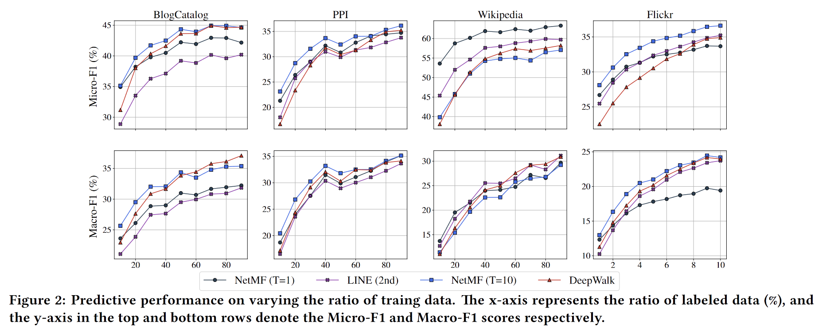
NetMF vs DeepWalk

Slide 15
Limitations
The NetMF works better than DeepWalk on certain tasks, especially those where short-term dependence is enough to capture the relationships (e.g. Wikipedia).
Factorisation methods can’t model second(+)-order tasks efficiently

Slide 16
Questions
How can this method model attributed edges? This would seem to be a tensor decomposition problem.
How to relate this analysis to Graph Neural Networks?
Can this be used to make online algorithms better? Both methods have advantages. Could initialising a more complex online algorithm with embeddings from a Factorisation method help?

Slide 17
Discussion

Slide 18
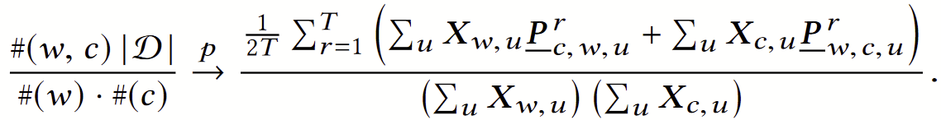
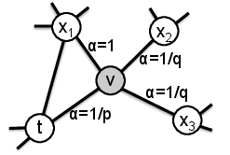
Node2Vec
Also give closed form version of Node2Vec (2nd order random walk):
Computation of the transition probability tensor P and corresponding stationary distribution X is very expensive
Accurate modeling of the full 2nd-order dynamics problematic

